Slide 1
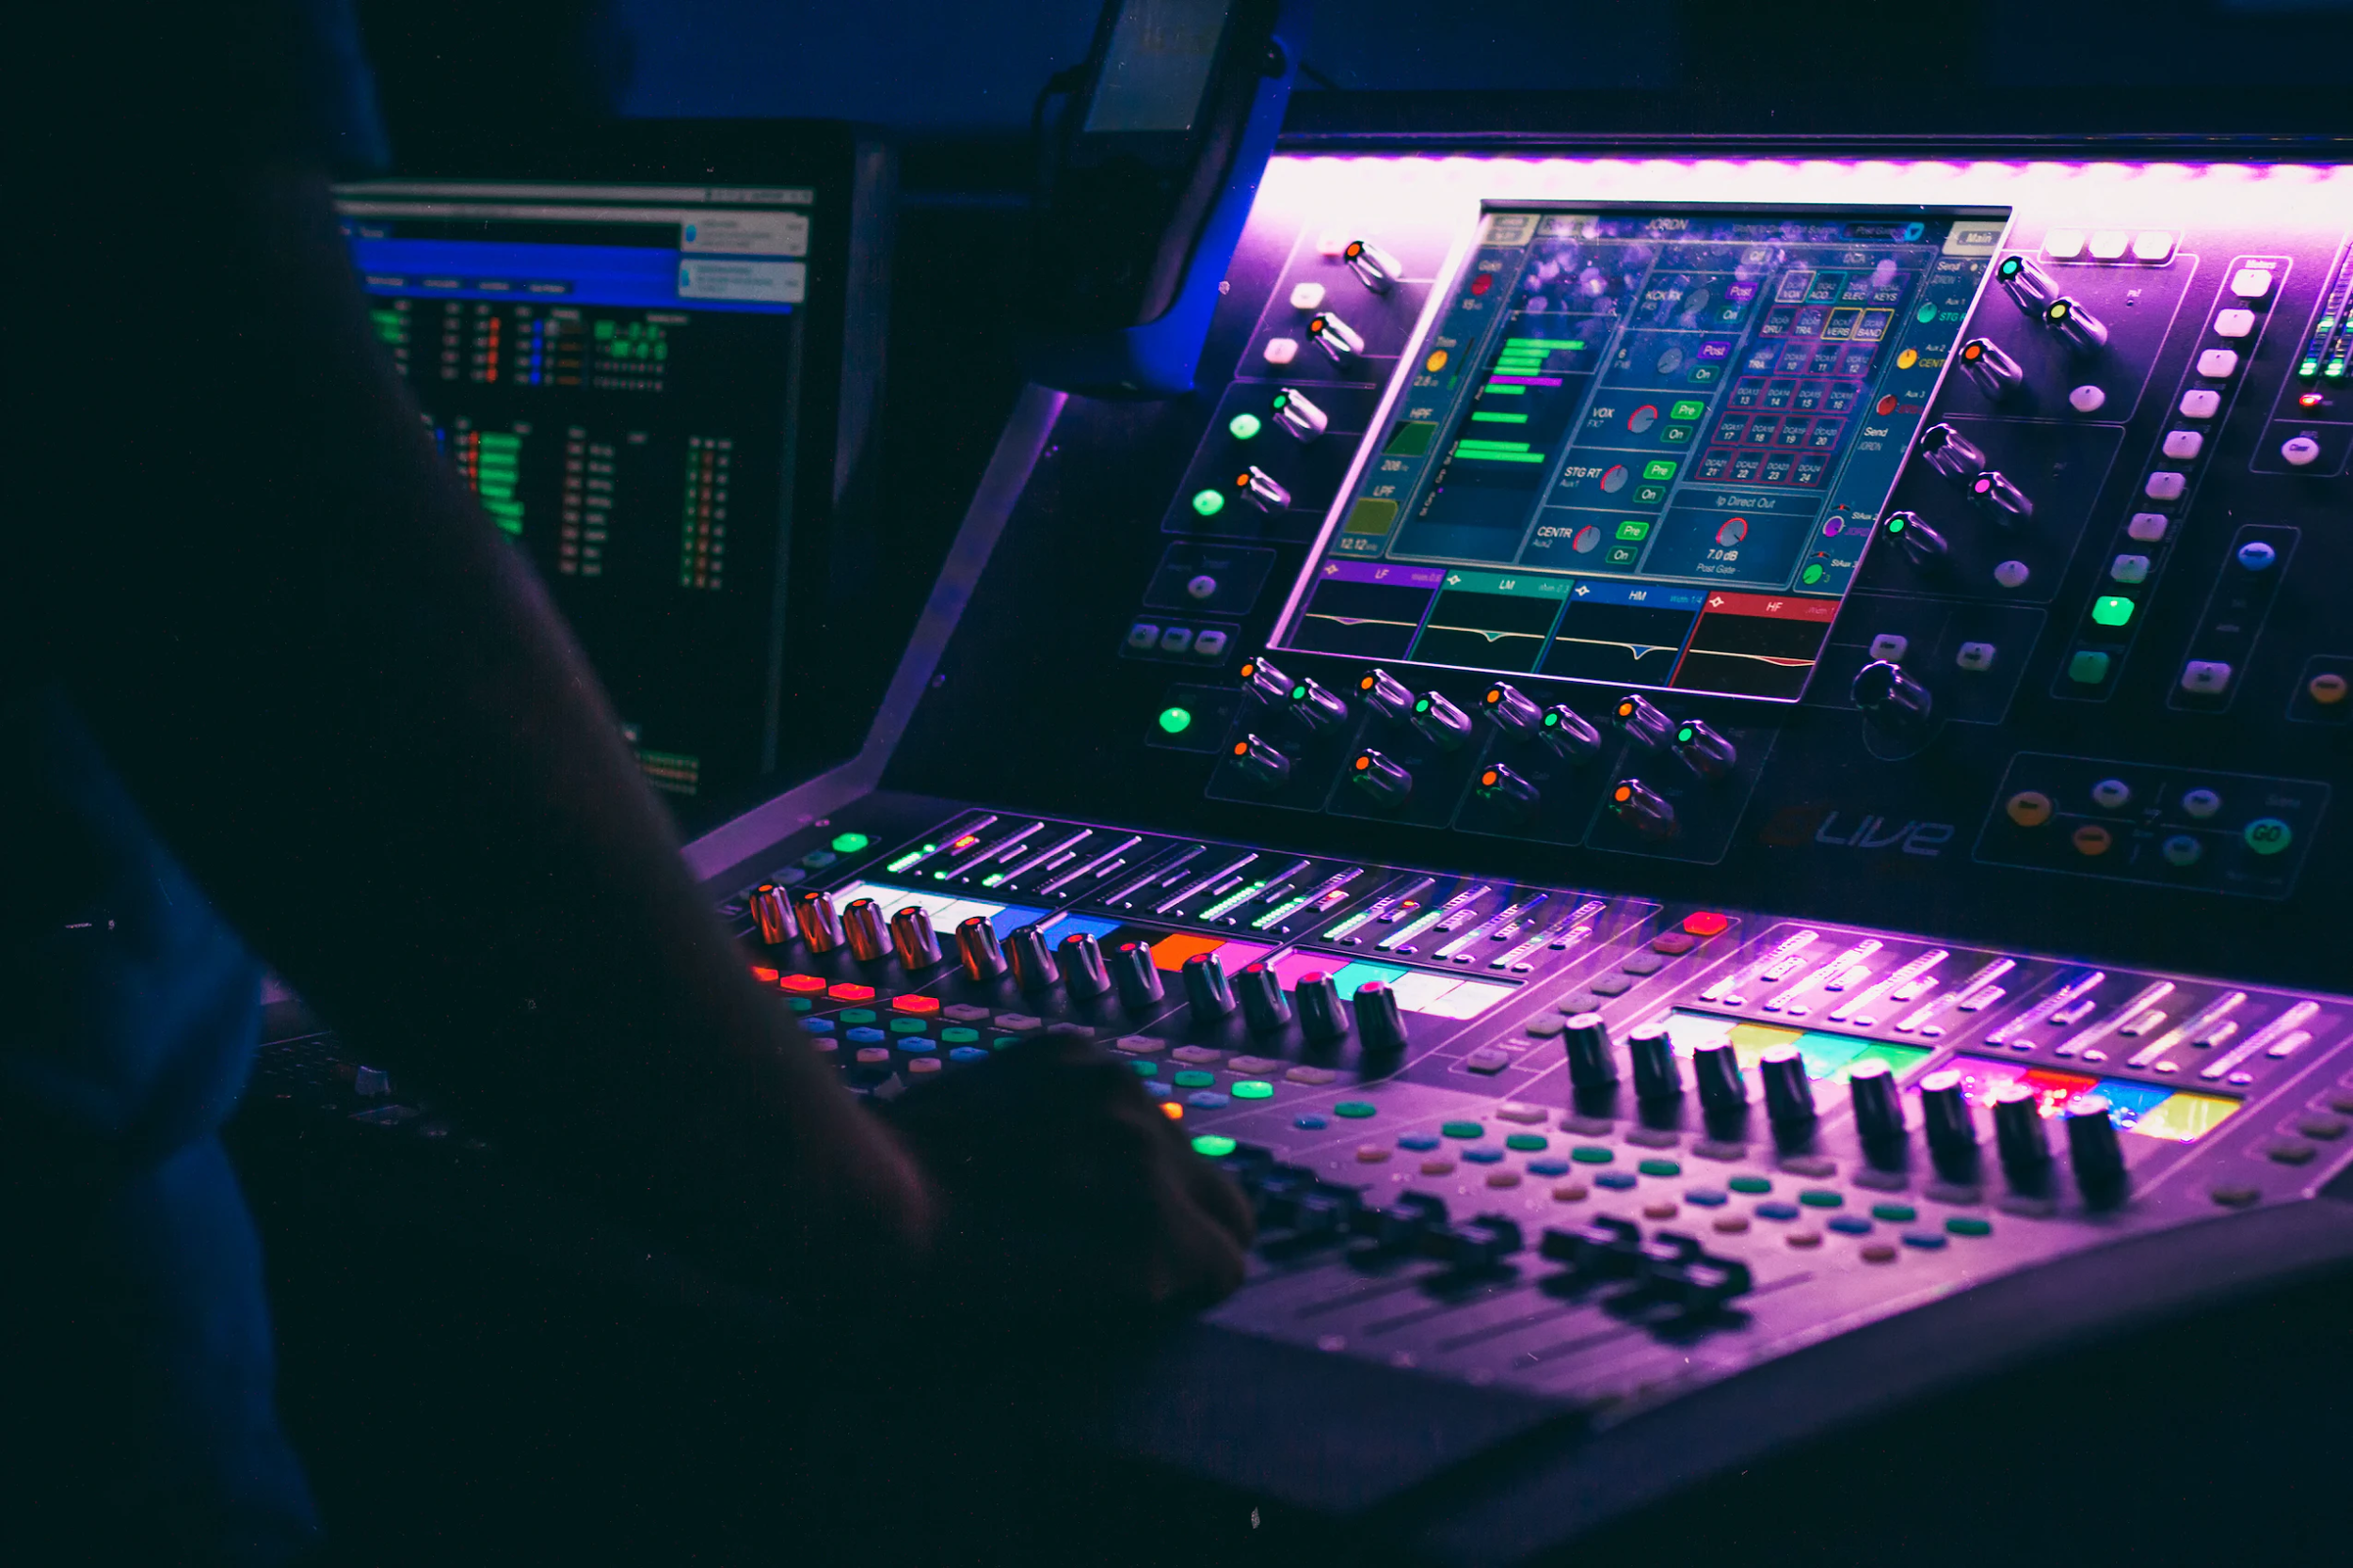

Honey, what was that?
An Audio Classifier for Household Sounds
Mateo Martinez
Data Science Capstone | December 2020

Slide 2
Redo notebook six to include analysis of slices of predictions

Slide 3
Introduction
In the last ten years that has been huge leaps forward in the field of computer vision, with algorithms gaining high level understanding of the digital images.
For this project, we will apply these image classification algorithms to audio files by converting the raw audio into three feature sets: Mel-Frequency Spectrogram images,and Mel-Frequency Cepstral Coefficient images, and the mean Mel-Frequency Cepstral Coefficient values. The dataset we will investigate is comprised of a variety of typical household sounds.
Goal
Apply machine learning classification algorithms to our converted audio files to predict to the class label of typical household sounds.

Slide 4
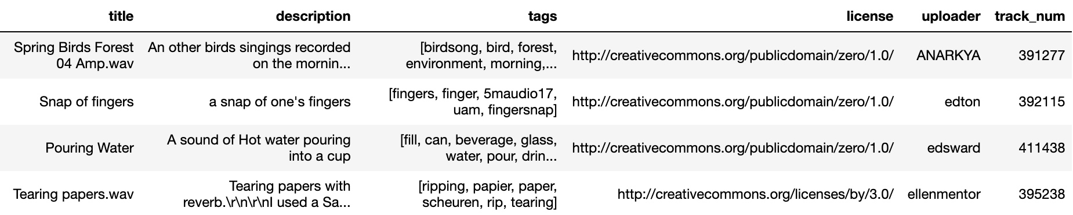
Data
The dataset for this project is titled Freesound Dataset 50k and was curated by The Music Technology Group of Universitat Pompeu Fabra.
It contains 50,000 raw audio wav files. The curators have pre-split the data set into a training set of 40,966 files and a test set of 10,231 files.
The dataset contains a title, description, and tags but no class labels, which need to be wrangled.
The audio files contain a wide array of sounds, from music, speech, animal,nature, city, and household sounds.

Slide 5
Business Application & Stakeholders
This audio classifier benefits stakeholders interested in home security systems. This algorithm could inform a resident of the category of a sound event, which could be used as an alert/warning system for unwarranted sounds.
This project benefits stakeholders interested in image based audio classification algorithms, as the comparative analysis of the Mel-Frequency, MFCC, and Mean-MFCC feature sets informs decisions for feature selection in future classification models.

Slide 6
Explanatory Features
To fully explore the best method of applying image classification algorithms, we will extract three different sets of features.
The First two sets of features, Mel-Frequency Spectrograms and Mel-Frequency Cepstral Coefficients Spectrograms, will be used to train Convolutional Neural Networks.
The Third set of features, the mean of the MFCC values over time elapsed, is now has a one dimensional feature space, which we will use to train non-image based classifiers: non-convolutional Neural Network, Logistic Regression, Random Forest, and Support Vector Classifier.

Slide 7
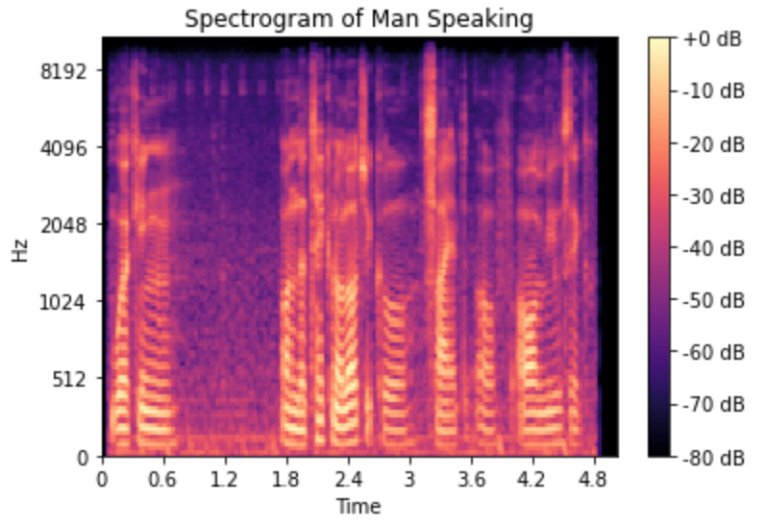
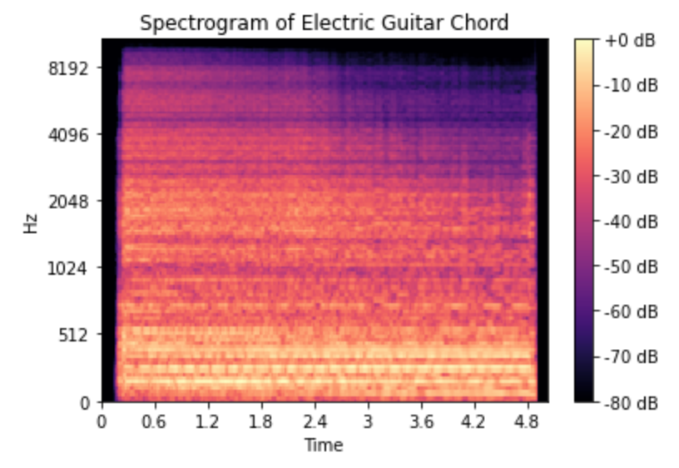
EDA: Mel-Frequency Spectrograms
Humans perceive sound logarithmically, thus to have a visualization that matches how we perceive equal increments of sound, we will cover the the audio to the Mel-Frequency scale.
For the Spectrogram, we will extract 128 Mel-Frequency bands, as the corresponds to the tonal range of human hearing. We will trim/pad the audio files to five seconds, extracting a total of 216 audio events with that period, resulting in a 128x216 pixel image.

Slide 8
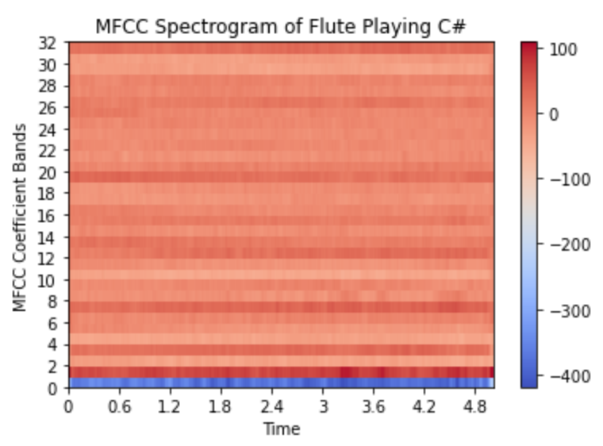
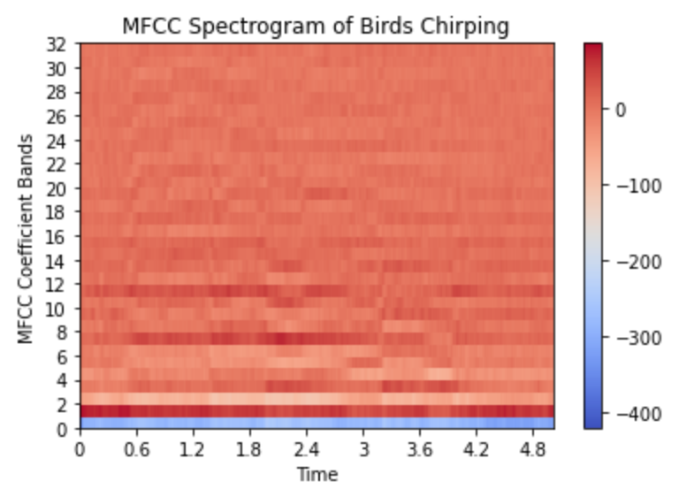
EDA: Mel-Frequency Cepstral Coefficient Spectrograms
The MFCC Spectrogram is a further compressed representation of a Mel-Frequency Spectrogram, taking the spectrum of the Mel-Frequency spectrum.
Typically for speech analysis, 12-13 Mel-Frequency bands are extracted for European languages and 20 for Asian languages.
However, given that this dataset set includes much more tonally nuanced audio events, we will extract 32 Mel-Frequency bands, with 216 audio events across the five second interval, resulting in 32x216 pixel images.

Slide 9
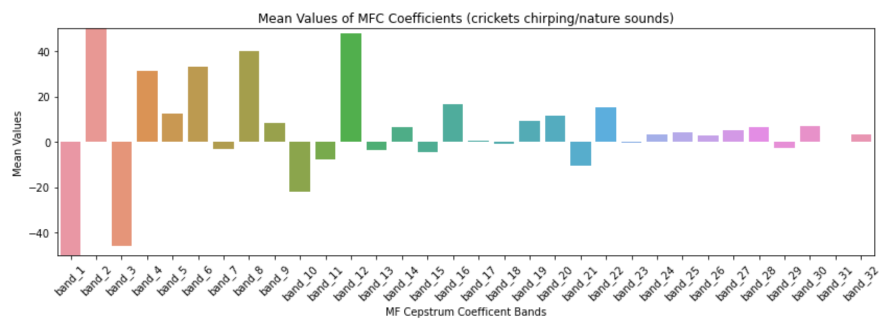
EDA: Mean MFCC Values
To use non-image based classifiers, we will take the mean of the MFFC values averaged over time. This will result in a one dimensional array of 32 features, each representing a Mel-Frequency band.

Slide 10
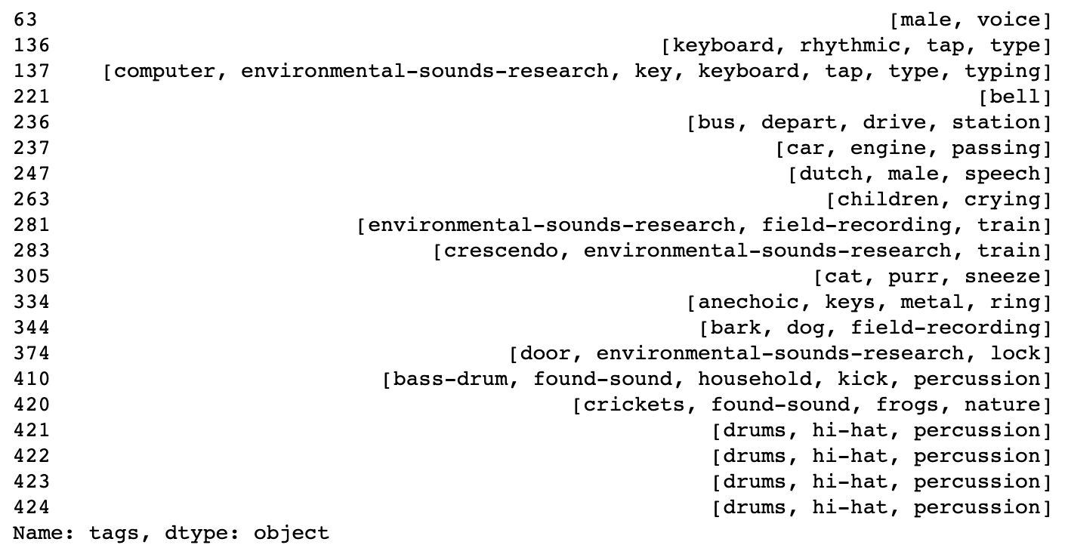
EDA-Audio Tags
This dataset was not curated with class labels. To wrangle class labels, we will use the audio tags, of which there are over 20,000 unique tags. Below is a sample of 20 rows of tags:

Slide 11
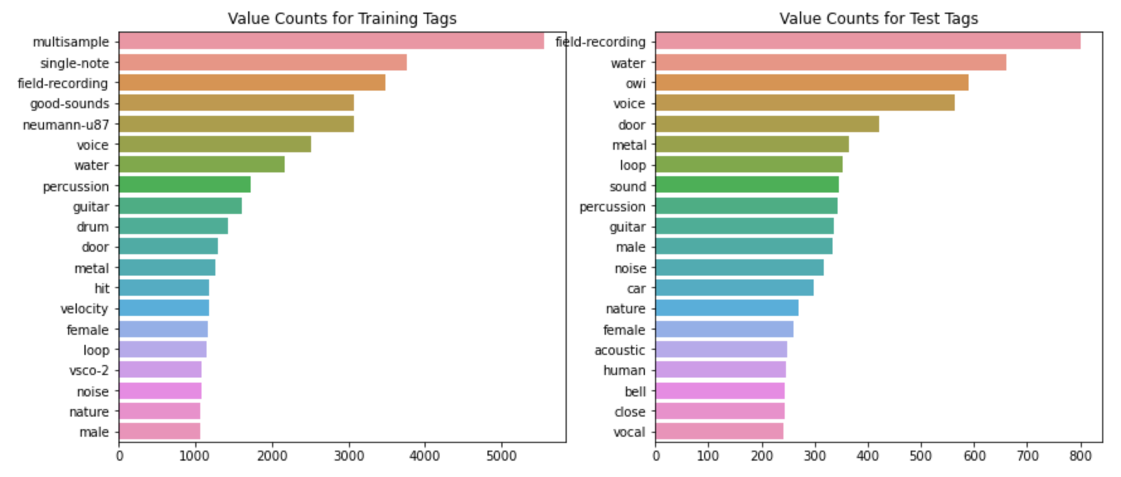
EDA - Audio Tags
These graphs depict the most frequently used tags for the training and test data. It is notable that between the two datasets there is quite a discrepancy between the most common tags.

Slide 12
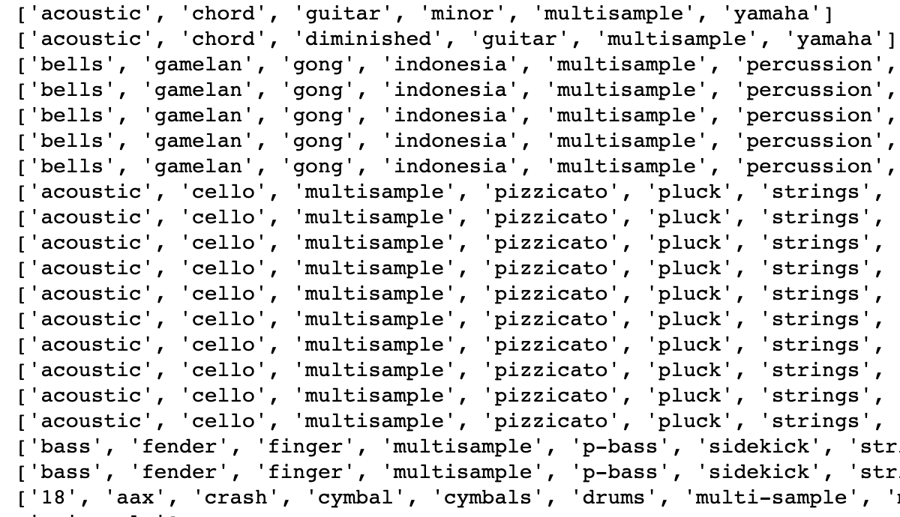
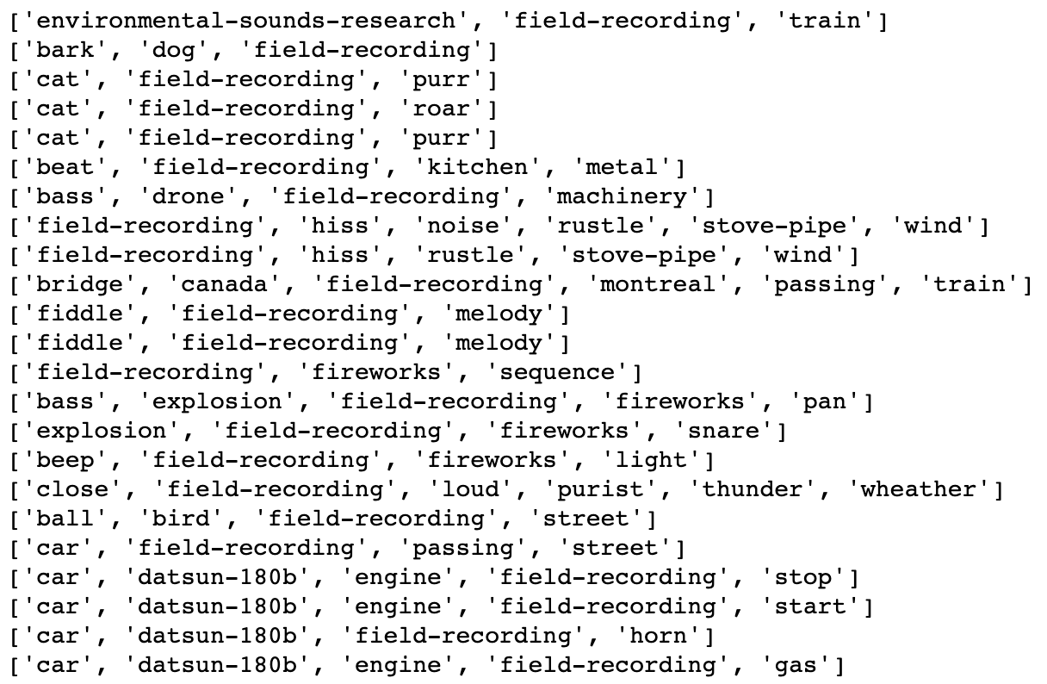
EDA - Audio Tags
Here is a look at the full tag metadata for highest tag counts:
Training:“multisample” Test: “field recording

Slide 13
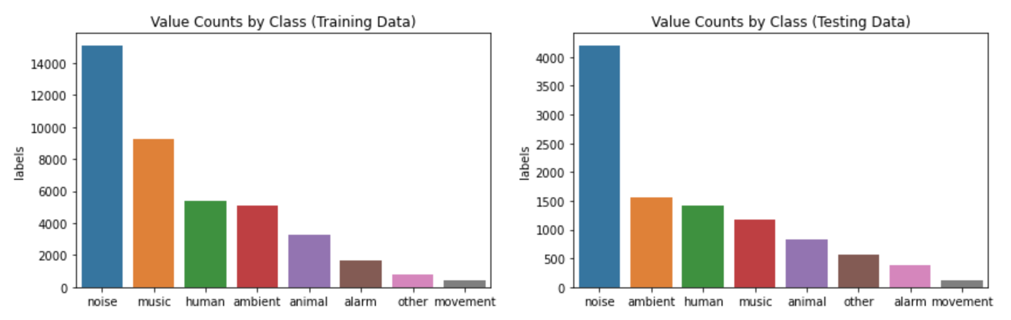
Imbalanced Classes
From these 20,000 unique, we will bin them into eight class labelled categories, by heuristically binning each tag into a class category. As is evident in the graphs below, there is significant imbalanced classes. We will resample the training data with random undersampling and random oversampling with data augmentation, consisting of adding gaussian noise and shifting the pitch.

Slide 14
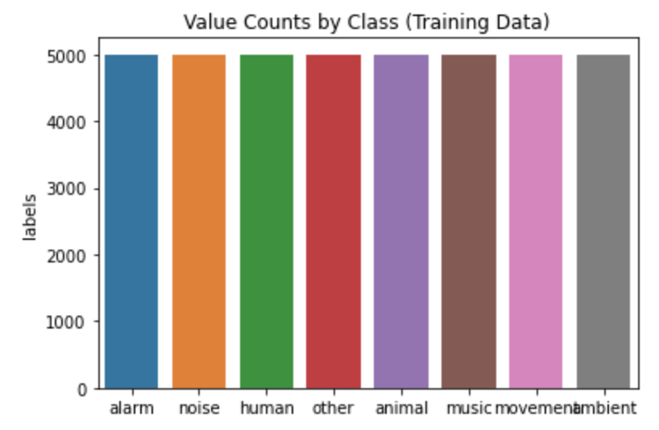
Resampled Training Data
After resampling the training data, each class contains 5,000 audio files.

Slide 15
Pre-Processing
Images scaled to a min-max range of zero to one
Mean MFCC values scaled with a zero mean and unit variance
Splitting Test data 50-50 into Validation and Test sets for neural network hyperparameter tuning
Minor data cleaning of dataframe columns used in EDA

Slide 16
Modeling
We will train a total of seven classification models using the three feature sets:
1a. Convolutional Neural Network with Mel-Frequency Spectrograms
2a. CNN with MFCC Spectrograms
2b. CNN with ResNet50 Transfer Learning with MFCC Spectrograms
3a. Neural Network with Mean MFCC Values
3b. Logistic Regression with Mean MFCC Values
3c. Random Forest with Mean MFCC Values
3d. Support Vector Classifier with Mean MFCC Values

Slide 17
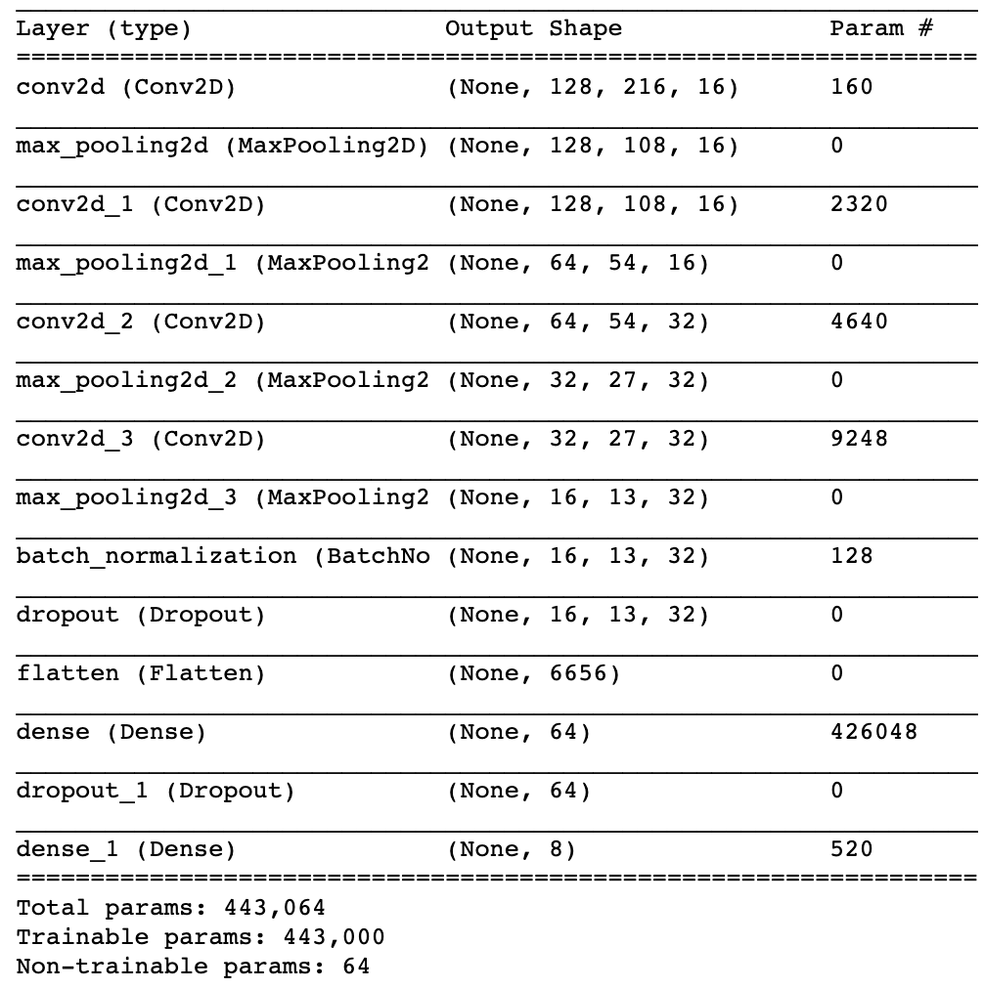
Modeling- CNN with Mel-Frequency Spectrograms
Given that the training and test datasets contained a significant proportion of distinct audio files, the biggest challenge was the model overfitting to the training set.
This was addressed with a combination of Max Pooling, Batch Normalization, Dropout layers, and relatively low number of filters.
Loss: Categorical Cross-Entropy
Optimizer: SGD
Epochs: 40

Slide 18
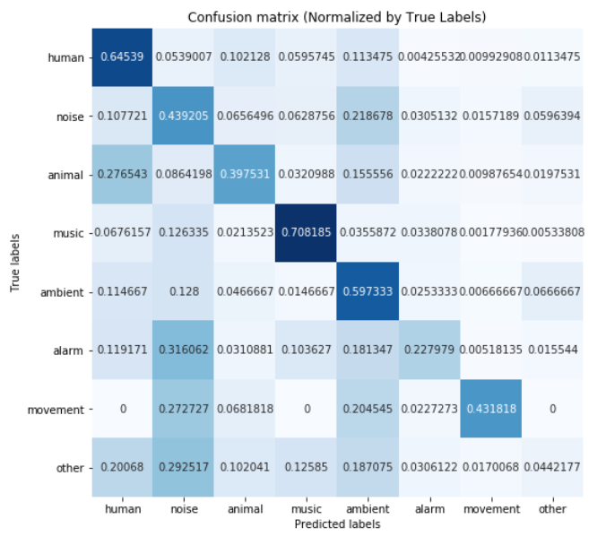
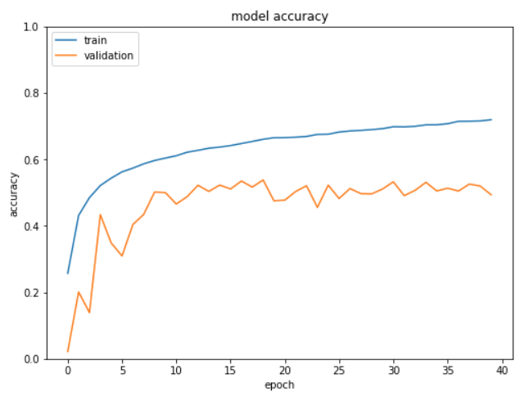
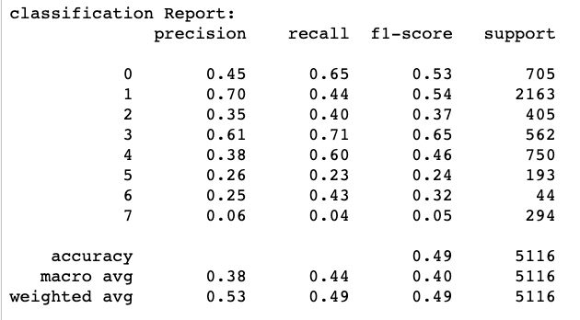
Modeling- CNN with Mel-Frequency Spectrograms
Results:
Train Accuracy: 0.7209 Test Accuracy: 0.49
Validation Accuracy: 0.4936 Test F1-Score: 0.40

Slide 19
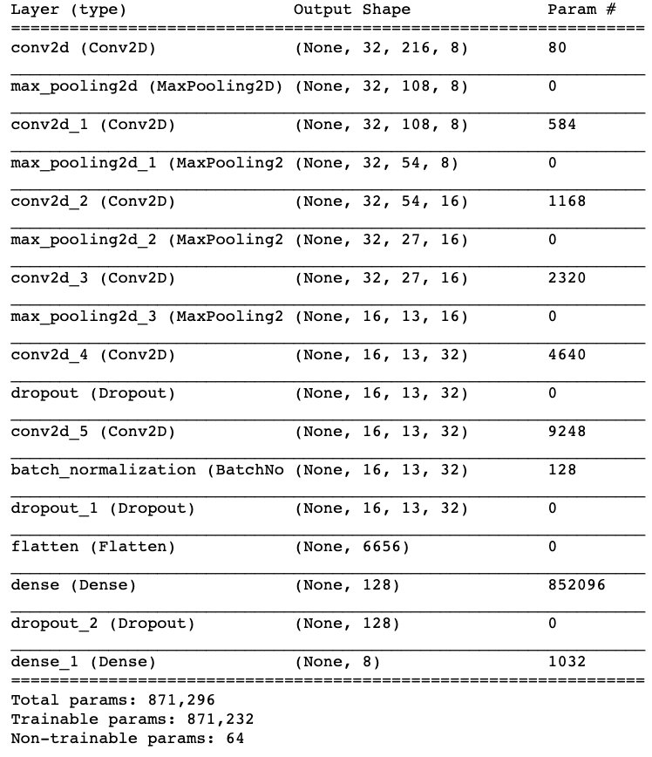
Modeling- CNN with MFCC Spectrograms
This model struggled with the same problem of overfitting and required the similar layer architecture, with slightly different Max Pooling layers and number of filters.
Loss: Categorical Cross-Entropy
Optimizer: SGD
Epochs: 40

Slide 20
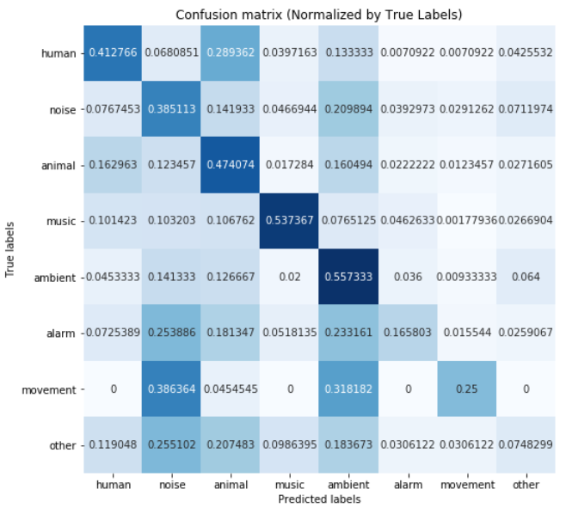
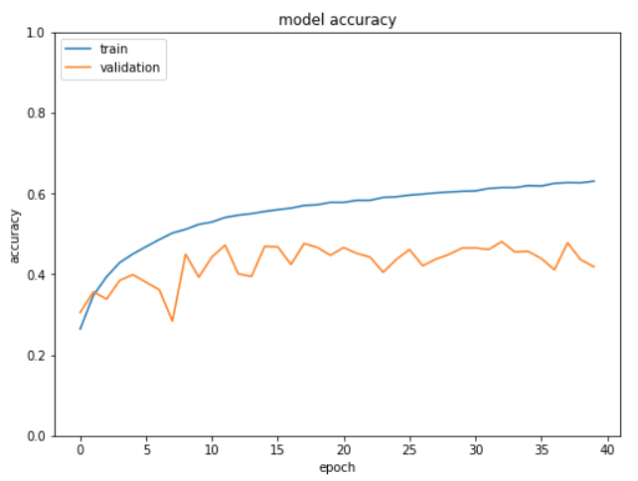
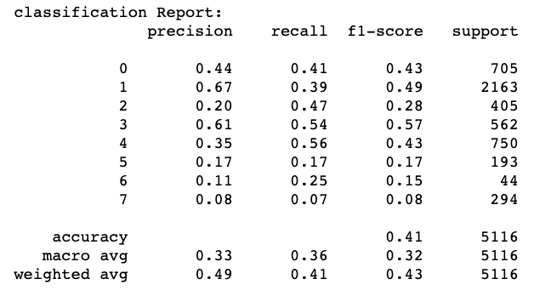
Modeling- CNN with MFCC Spectrograms
Results:
Train Accuracy: 0.6279 Test Accuracy: 0.41
Validation Accuracy: 0.4186 Test F1-Score: 0.32

Slide 21
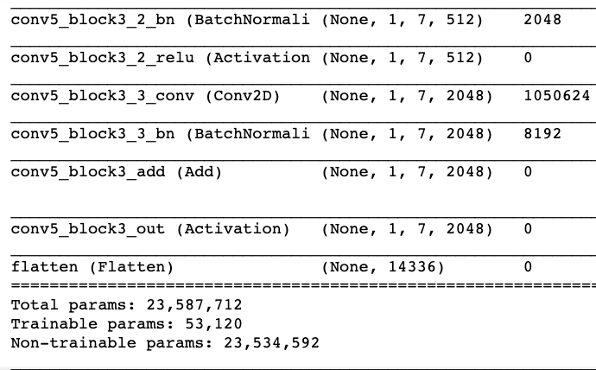
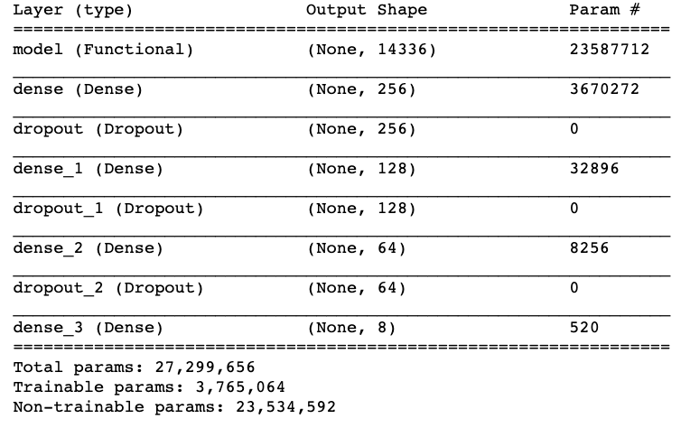
Modeling- CNN with ResNet50 with MFCC Spectrograms
This model was trained using Keras to import the ResNet50 model with ImageNet weights. Trainable layers of the ResNet model were unfrozen.
This model did not perform as well as expected potentially due to the difference between input image dimensions used on the ImageNet dataset.
Loss: Categorical Cross-Entropy
Optimizer: SGD
Epochs: 40

Slide 22
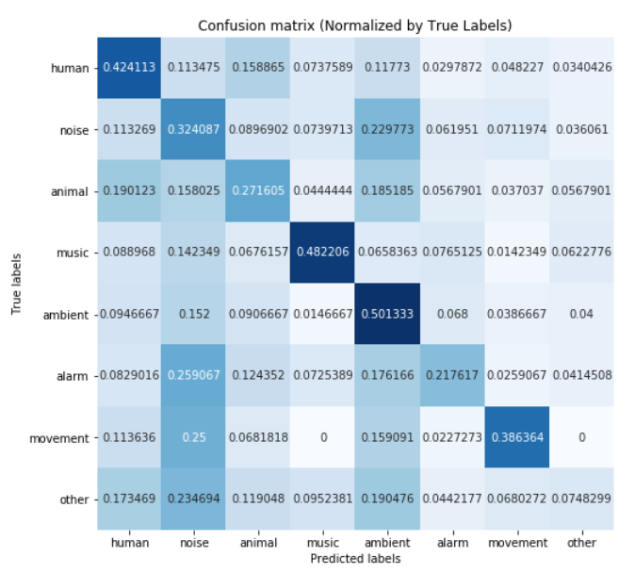
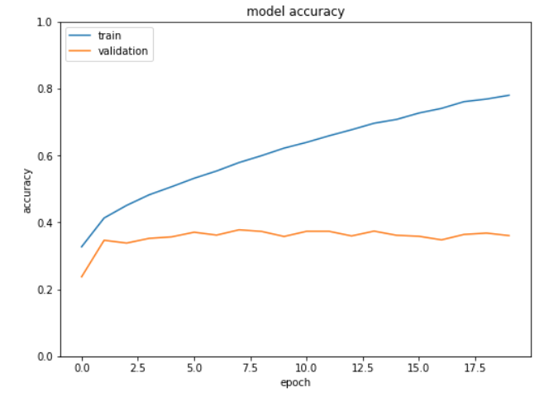
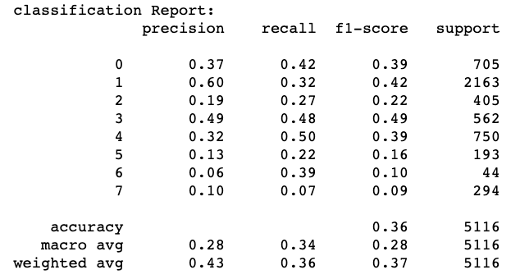
Modeling- CNN with ResNet50 with MFCC Spectrograms
Results:
Train Accuracy: 0.7870 Test Accuracy: 0.36
Validation Accuracy: 0.36 Test F1-Score: 0.28

Slide 23
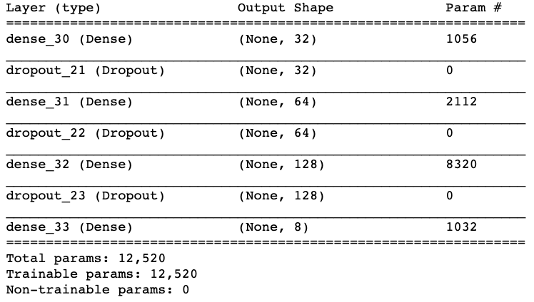
Modeling- Neural Network with Mean MFCC Values
This model used a non-convolutional neural network architecture, given the one dimensional feature space.
This model did not have the highest accuracy or F1-score, but its training speed was over twenty times faster than the fastest CNN model.
Loss: Categorical Cross-Entropy
Optimizer: SGD
Epochs: 40

Slide 24
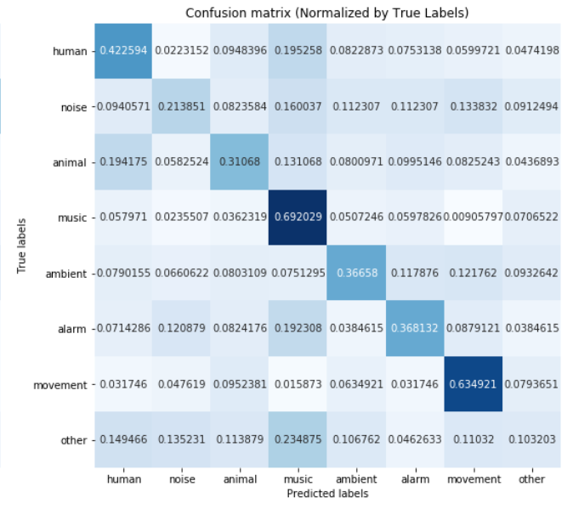
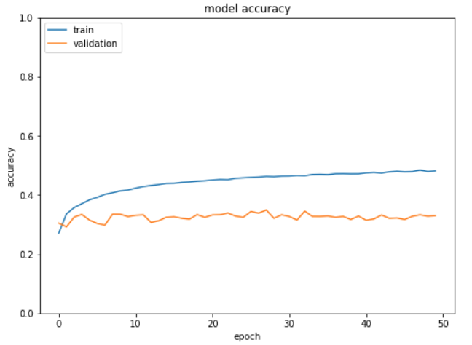

Modeling- Neural Network with Mean MFCC Values
Results:
Train Accuracy: 0.4805 Test Accuracy: 0.33
Validation Accuracy: 0.3301 Test F1-Score: 0.29

Slide 25
Modeling- Logistic Regression with Mean MFCC Values
This model has been implemented to provide a baseline with which to compare the classifiers.
Additionally we will later use the coefficients of this model to derive an approximated feature importance.
Regularization: Elastic Net
L1/L2 Ratio: 0.5
Optimizer: Stochastic Average Gradient Descent
Max Iterations: 500

Slide 26
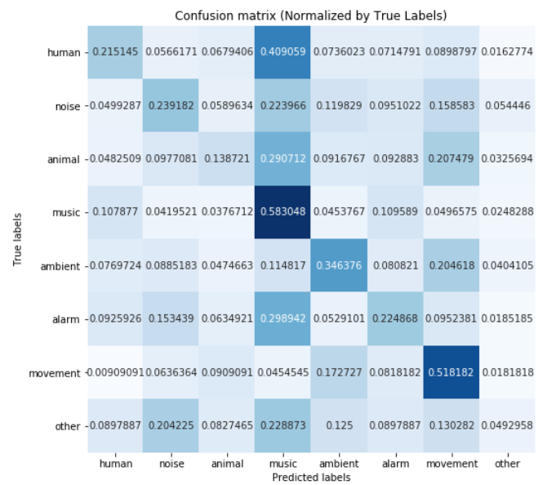
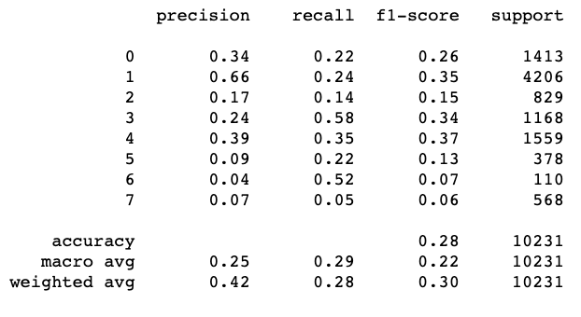
Modeling- Logistic Regression with Mean MFCC Values
Results:
Train Accuracy: 0.37
Test Accuracy: 0.28
Test F1-Score: 0.22

Slide 27
Modeling- Random Forest with Mean MFCC Values
This Random Forest model utilized a random grid search for hyperparameter tuning. The random grid search was conducted with fifty iterations with three fold cross-validation.
Grid Search: n_estimators: 50-500 trees,
max_features: binary logarithm, square root
max_depth: 5-50 levels
Best Parameters: n_estimators: 476,
max_features: 'sqrt',
max_depth: 41

Slide 28
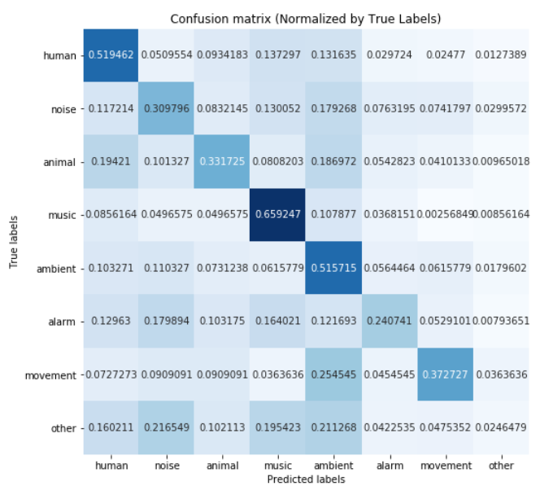
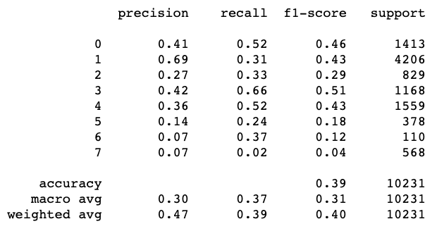
Modeling- Random Forest with Mean MFCC Values
Results:
Train Accuracy: 0.47
Test Accuracy: 0.39
Test F1-Score: 0.31

Slide 29
Modeling- Support Vector Classifier with Mean MFCC Values
This Support Vector Classifier utilized random grid search for hyperparameter tuning. The random grid search was performed with 20 iterations with three fold cross-validation. It is notable this was by far the slowest model to tune and train.
param_distributions = {"gamma": reciprocal(0.001, 1),
"C": uniform(0.1, 100),
"kernel": ['linear','rbf']}
Best Estimator = {"gamma": 0.20592,
"C": 75.0634,
"kernel": “radial bias function”}

Slide 30
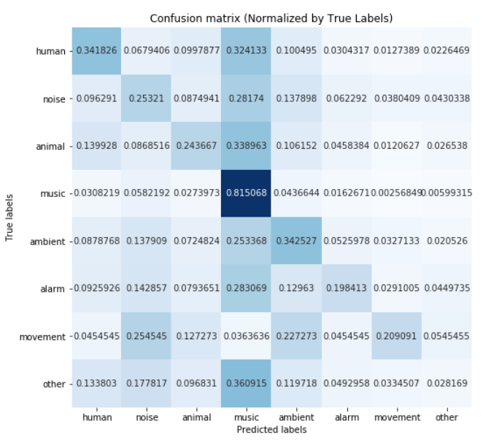
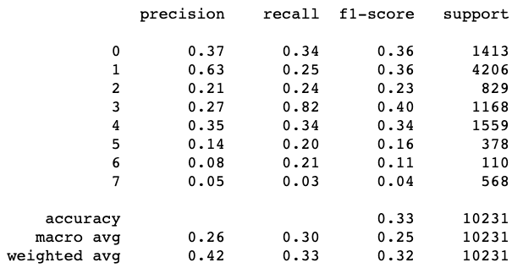
Modeling- Support Vector Classifier with Mean MFCC Values
Results:
Train Accuracy: 0.41
Test Accuracy: 0.33
Test F1-Score: 0.32

Slide 31
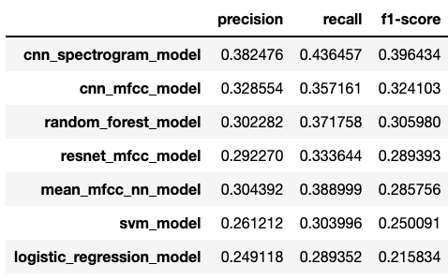
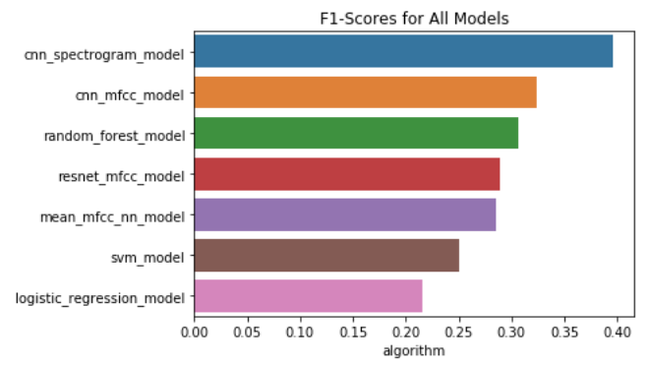
Model Analysis
The evaluation metric for the best model we will use is F1-score, as it balances considerations for both false positives and false negatives.
The Convolutional Neural Network trained with Mel-Frequency Spectrograms not only had the highest F1-score, but the highest precision and recall as well.

Slide 32
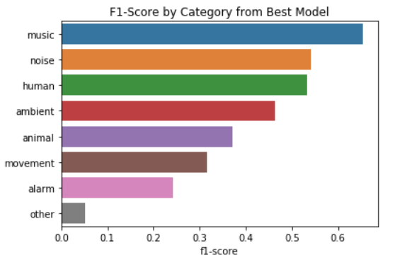
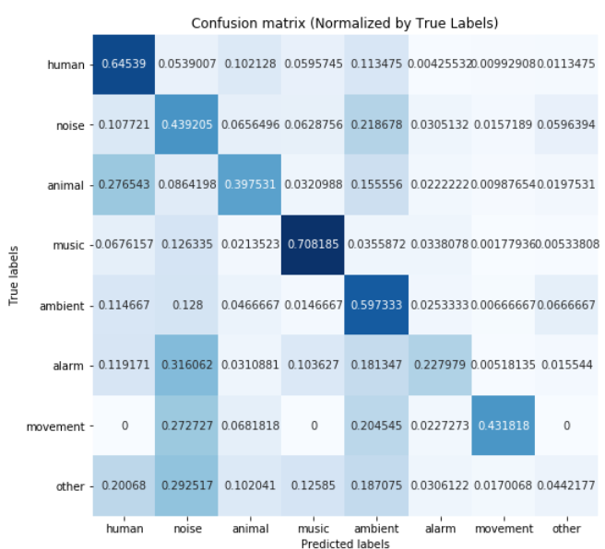
Model Analysis: Best Model

Slide 33
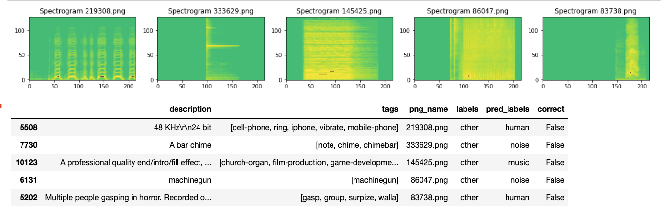
Modeling: What Went Wrong?
Row 10123: the predicted label was music and in fact the track metadata describes it as a church organ. Row 5202: the predicted label is human and the metadata describes the audio as people gasping.
These examples highlight mislabelled tracks where the algorithm actually predicted the correct label but was scored as incorrect.

Slide 34
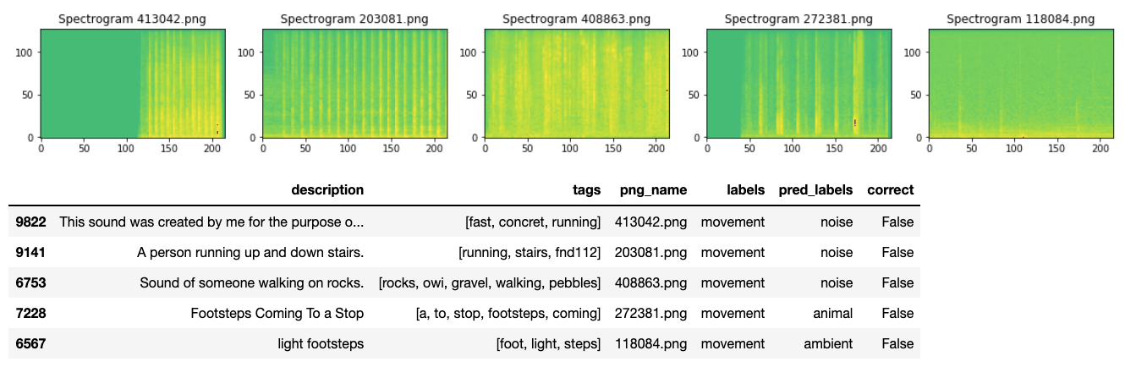
Modeling: What Went Wrong?
In four of these samples the model did not classify these tracks as movement, but rather as noise and ambient, which is a rather granular distinction. In future model development it was been advantageous to either use different ontological class labels or use data with clearer class distinctions.

Slide 35
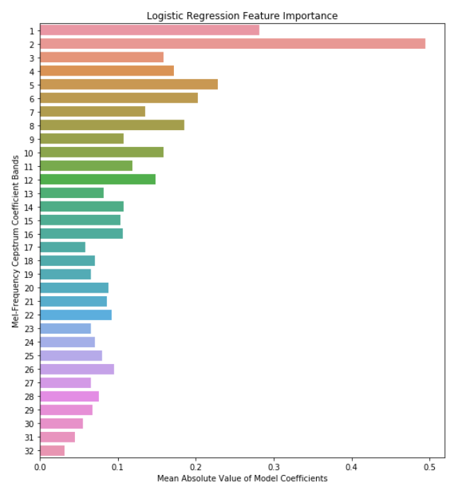
Business Recommendation: Feature Importance
Utilize the Feature Importance derived from the Logistic Regression and Random Forest models. In the graph we can see that the first twelve Mel-Frequency Bands have the highest Feature Importance a determined by the mean absolute the model’s coefficients. However there still is a significant proportion of Feature Importance in the last twenty features.

Slide 36
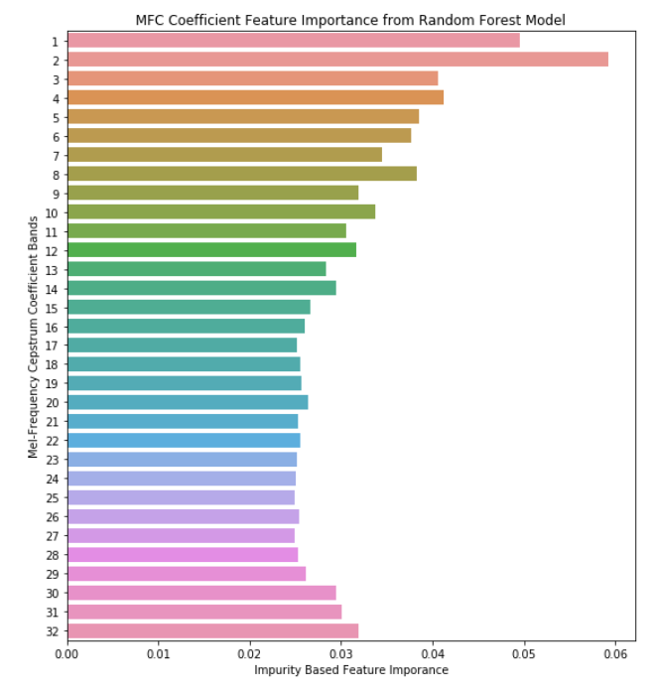
Business Recommendation: Feature Importance
This graph depicts the Feature Importance as determined by each feature’s Gini Impurity. Here we see an even higher proportion of Feature Importance in the last twenty Mel-Frequency bands.
Recommendation: Stakeholders interested training CNN models with MFCC images would benefit from extracting more than the standard 12-13 Mel-Frequency bands, with justification in extracting 32 bands.

Slide 37

Business Recommendation: MF vs MFCC Spectrograms
2. Model results from this comparative analysis show much higher accuracy and F1-score with the MF Spectrogram features. However, training time was three times slower with the MF Spectrograms.
Recommendation: Stakeholders interested in classifying audio with CNNs would benefit from using Mel-Frequency Spectrograms if training time is not a primary consideration.

Slide 38
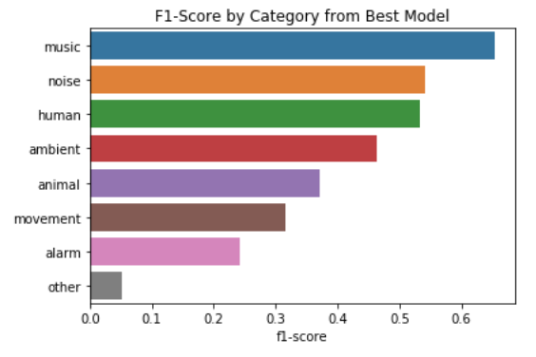
Business Recommendation: Retrain as Music Classifier
3. The best model’s highest F1-score class was music. This correlates with the fact that the dataset’s majority class was music as well. This model still struggled with the minority classes even with over sampling and data augmentation.
Recommendation: Stakeholders interested in higher accuracy models would benefit from re-training this model as a binary classification model to identify music or as a multi-classification model to classify specific musical instruments.

Slide 39
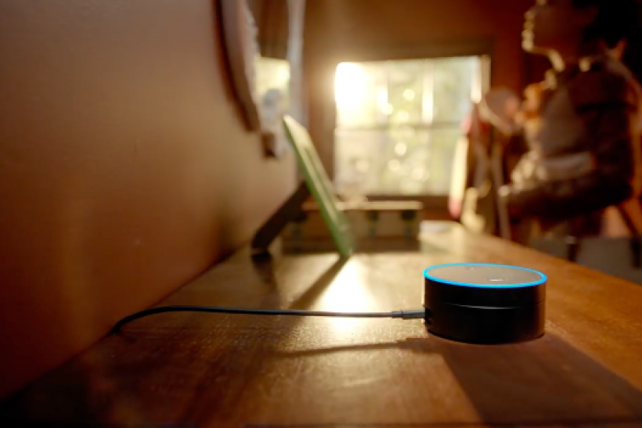
Business Recommendation: Model as Home Security System
3. While this model was benefit from increased training data, the CNN model has the existing architecture to be used as a framework for a home alert system.
Recommendation: Stakeholders interested in home security could build this model into an app that could alert homeowners of unwarranted audio events. For example, human when sounds when owner is out of the house, or alarm sounds such as breaking glass at anytime.

Slide 40
Next Steps
Build this classification model into an app where a user could record and input raw audio in real time and receive a prediction for the class of the audio event.
Improve model accuracy by obtaining a larger training dataset or a dataset without multi-label audio events.
Explore different transfer learning models such as VGG-19 and InceptionV3.

Slide 41
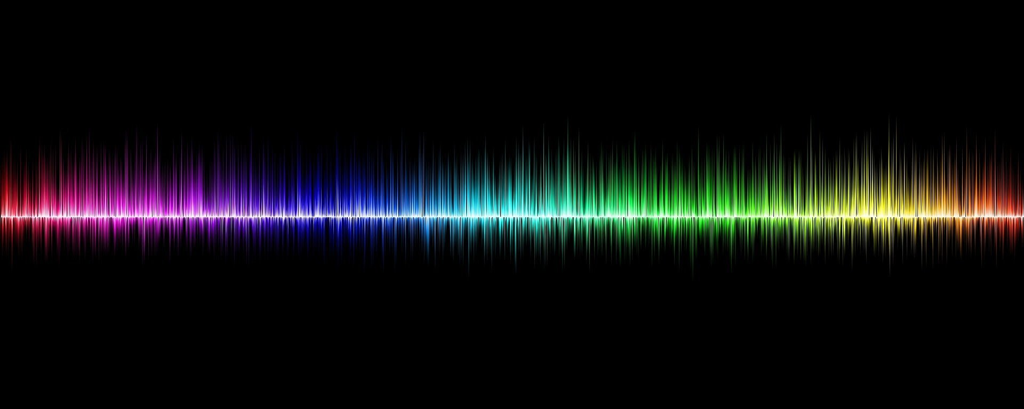
Mateo Martinez
mateomartinez510@gmail.com
linkedin.com/in/mateomartinez510
github.com/mateomartinez510
The End.

